Slide 1


A Design of a Complete Network Communication System (L1&L2)
Xiwen Huang
Team GUOLAIBU
EEE, SUSTech
Southern University of Science and Technology

Slide 2
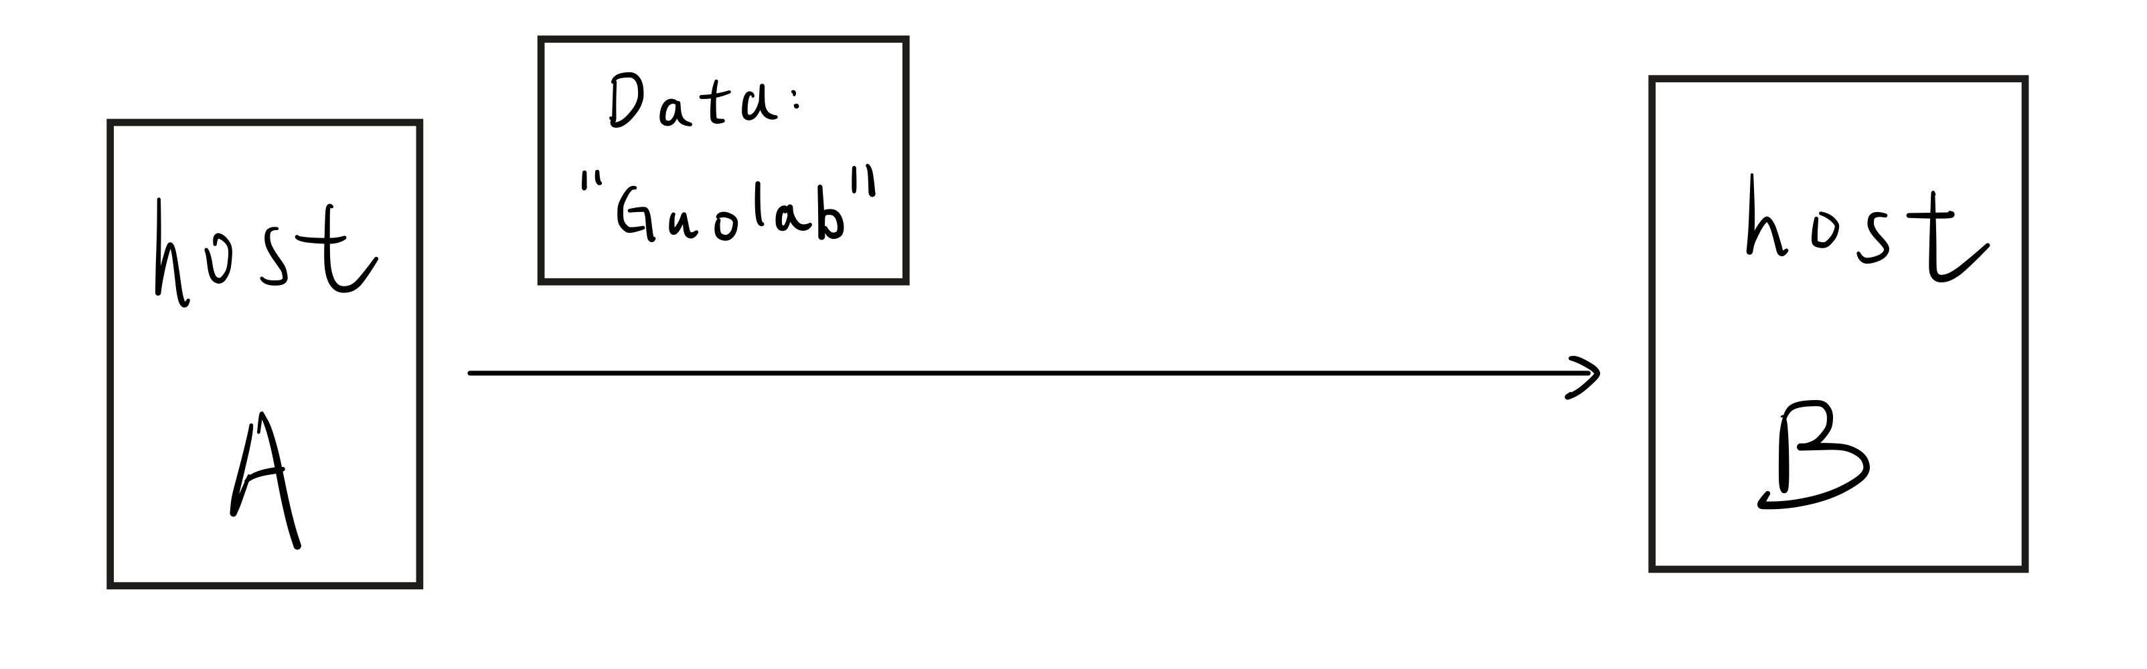
Why Communication?
Host B requires data from host A for its own application.
Southern University of Science and Technology

Slide 3
We need to build a network communication system!
To enable communication,
Southern University of Science and Technology

Slide 4
Simplest Case: Point-to-Point (P2P)
No network layer and above.
No host identifying, no addressing, routing or forwarding.
No src and dst headers in frame building.
Focus on physical and link layer:
Digital signal generation, modulation, transmission, demodulation, data recovery.
Longer message (fragmentation), error detection.
Southern University of Science and Technology

Slide 5
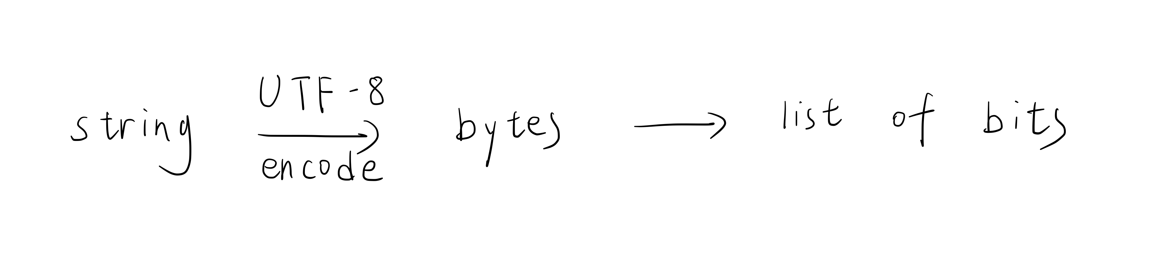
P2P: Digital signal generation & data recovery
One-to-one correspondence (UTF-8).
Eg: “我”——“1101” (Just a demonstration, not accurate.)
Southern University of Science and Technology

Slide 6
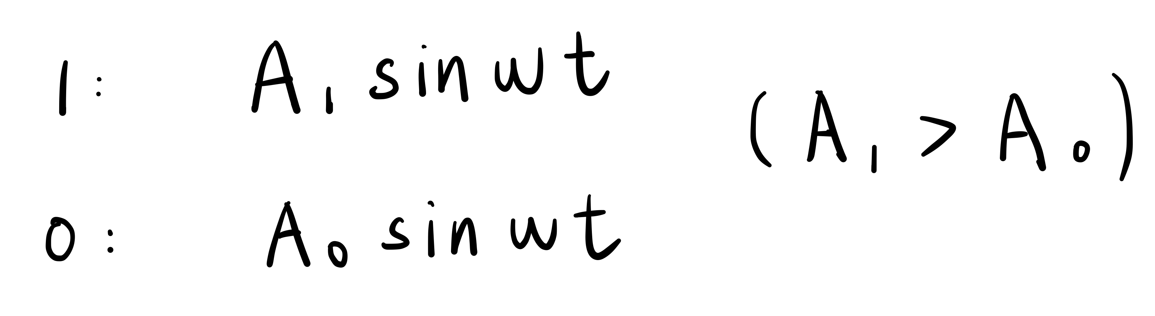
P2P: Modulation (Digital to Analog)
ASK (Amplitude Shift Keying)
Change 1/0 to samples of sine functions.
Southern University of Science and Technology

Slide 7
P2P: Modulation (Digital to Analog)
Our design:
A₀ = 0.1
A₁ = 1.0
Southern University of Science and Technology

Slide 8
P2P: Transmission
Analog
Attenuation, noise (which may cause bit error)
Propagation delay
Southern University of Science and Technology

Slide 9
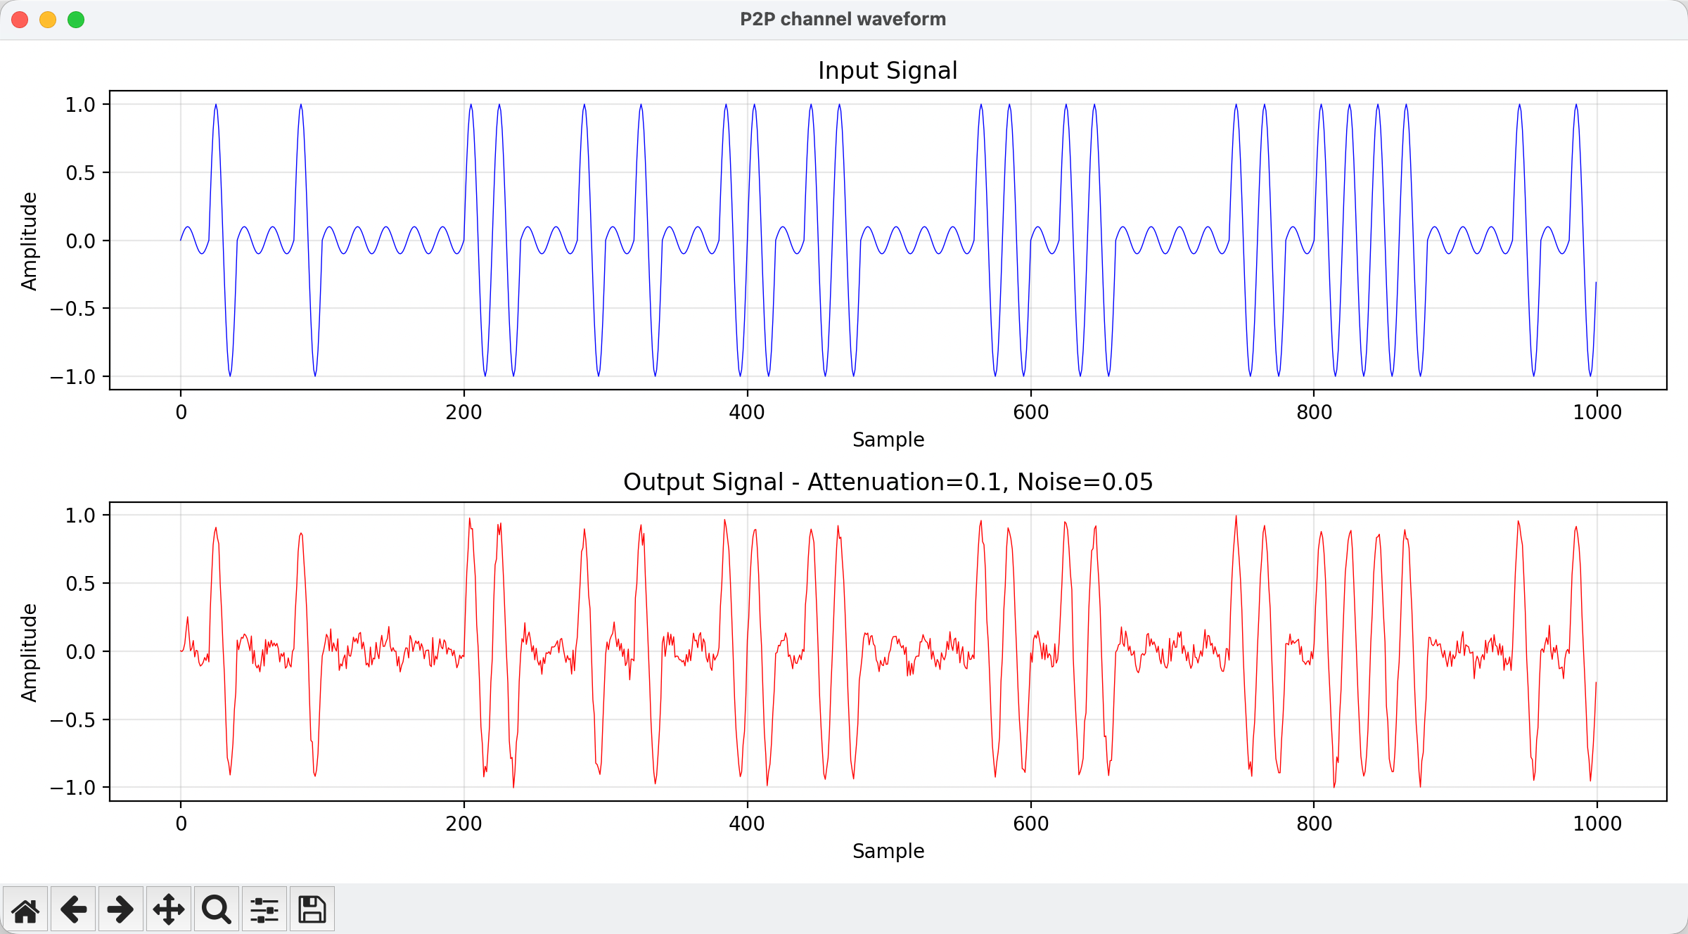
P2P: Transmission
Southern University of Science and Technology

Slide 10
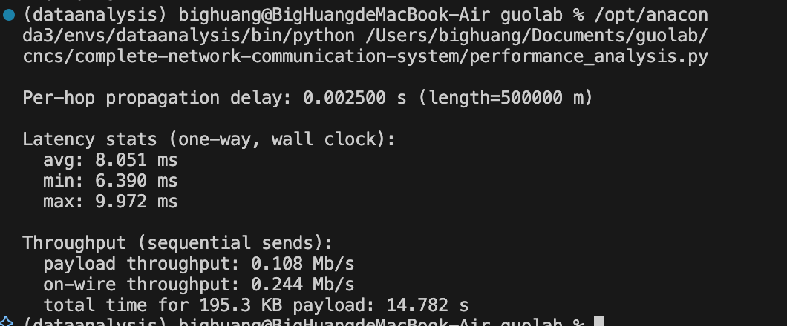
P2P: Transmission (Performance Analysis)
Southern University of Science and Technology

Slide 11
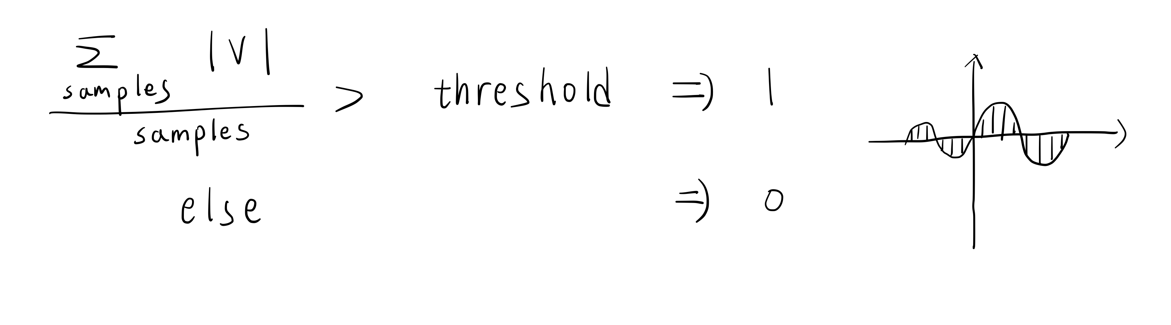
P2P: Demodulation (Analog to Digital)
Threshold: (= 0.3 in our design)
Southern University of Science and Technology

Slide 12
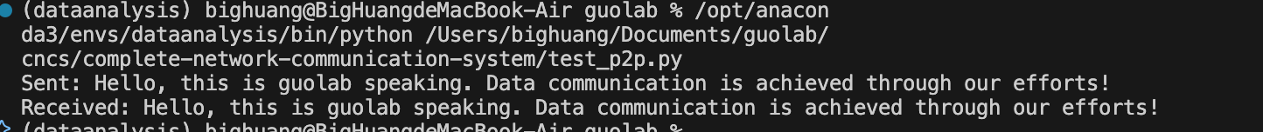
P2P: Result
Southern University of Science and Technology

Slide 13
P2P: Longer message
The sender splits a long message into multiple fragments of a fixed size (64 bytes). Each fragment is prefixed with a 6-byte header consisting of: message_id (2 bytes, an identifier for the message), fragment_index (2 bytes, the index of this fragment), and total (2 bytes, the total number of fragments). Each fragment is then individually encapsulated into a frame and transmitted over the physical channel.
On the receiver side, a reassembly buffer is created based on message_id. As fragments arrive, they are inserted into a dictionary according to their fragment_index. When all total fragments have been received, the receiver concatenates (连接) them in order to reconstruct the complete byte sequence, then decodes it using UTF-8 to recover the original message.
Southern University of Science and Technology

Slide 14
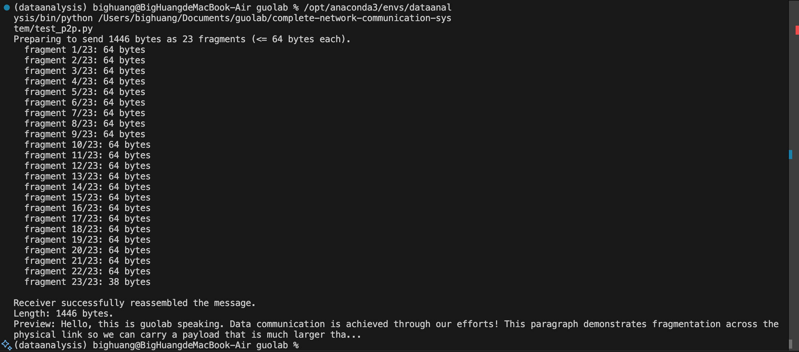
P2P: Longer message
Southern University of Science and Technology

Slide 15
P2P: Error detection
Parity check
Byte -- 8 bits a block:
For even number of 1s: add 0 as the parity bit
For odd number of 1s: add 1 as the parity bit
Finally, payload + parity have an even number of 1s in total. (1)
Receiver: Check if (1) is true. (Also check if the length of total bits is multiples of nine.)
Southern University of Science and Technology

Slide 16
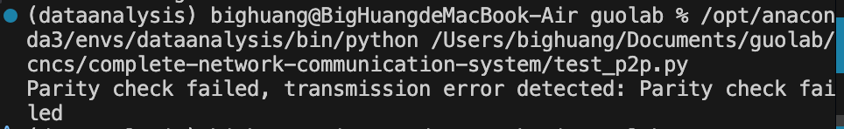
P2P: Error detection
Change Threshold to 0.05:
Southern University of Science and Technology

Slide 17
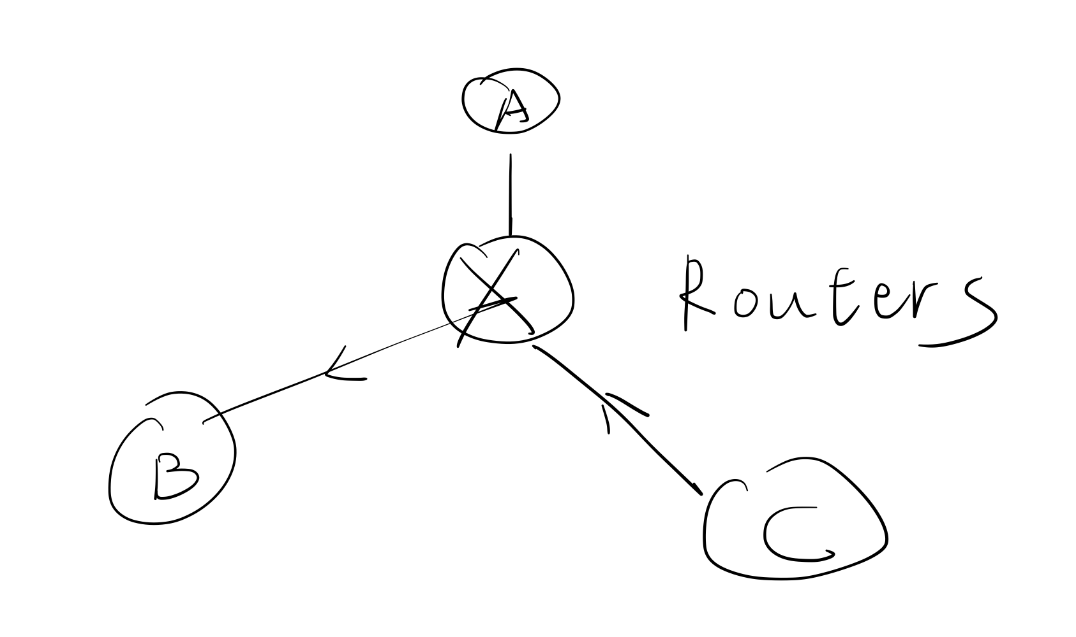
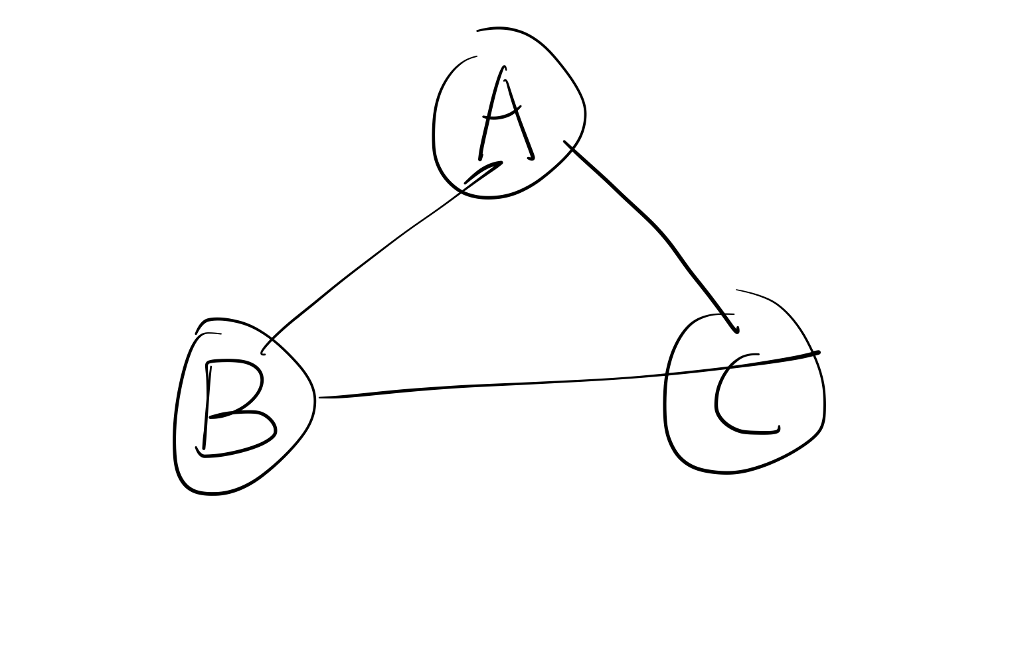
Multi-host System
Design 1
No scalability
Design 2
Scalable
Southern University of Science and Technology

Slide 18
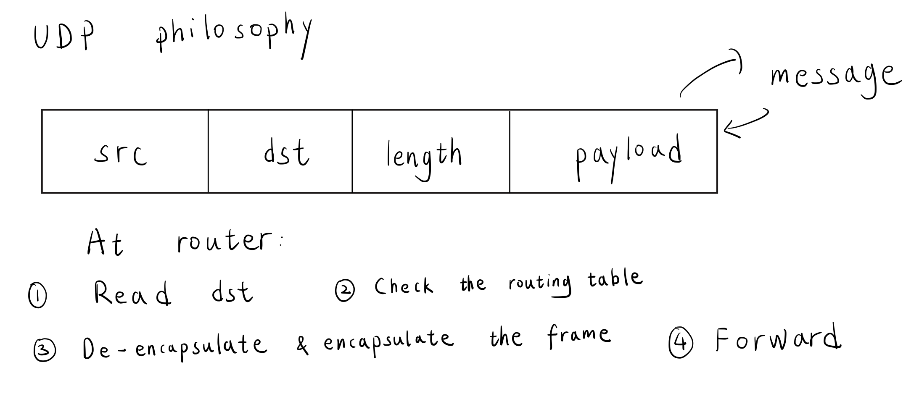
Multi-host: Router
Southern University of Science and Technology

Slide 19
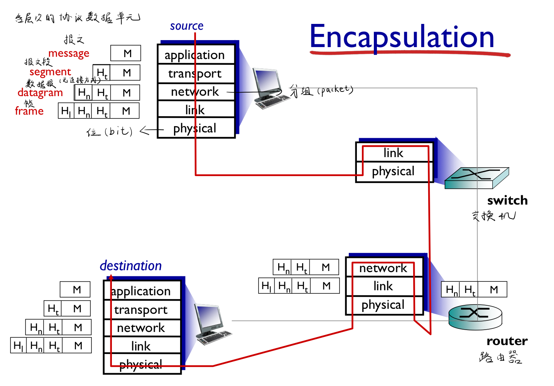
Multi-host: Workflow
Southern University of Science and Technology

Slide 20
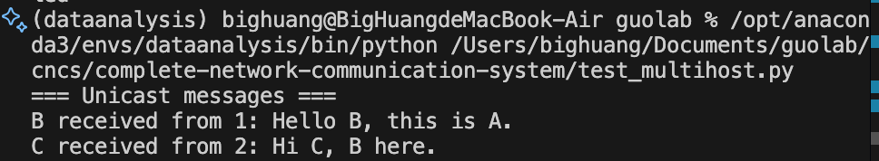
Multi-host: Result
Southern University of Science and Technology

Slide 21
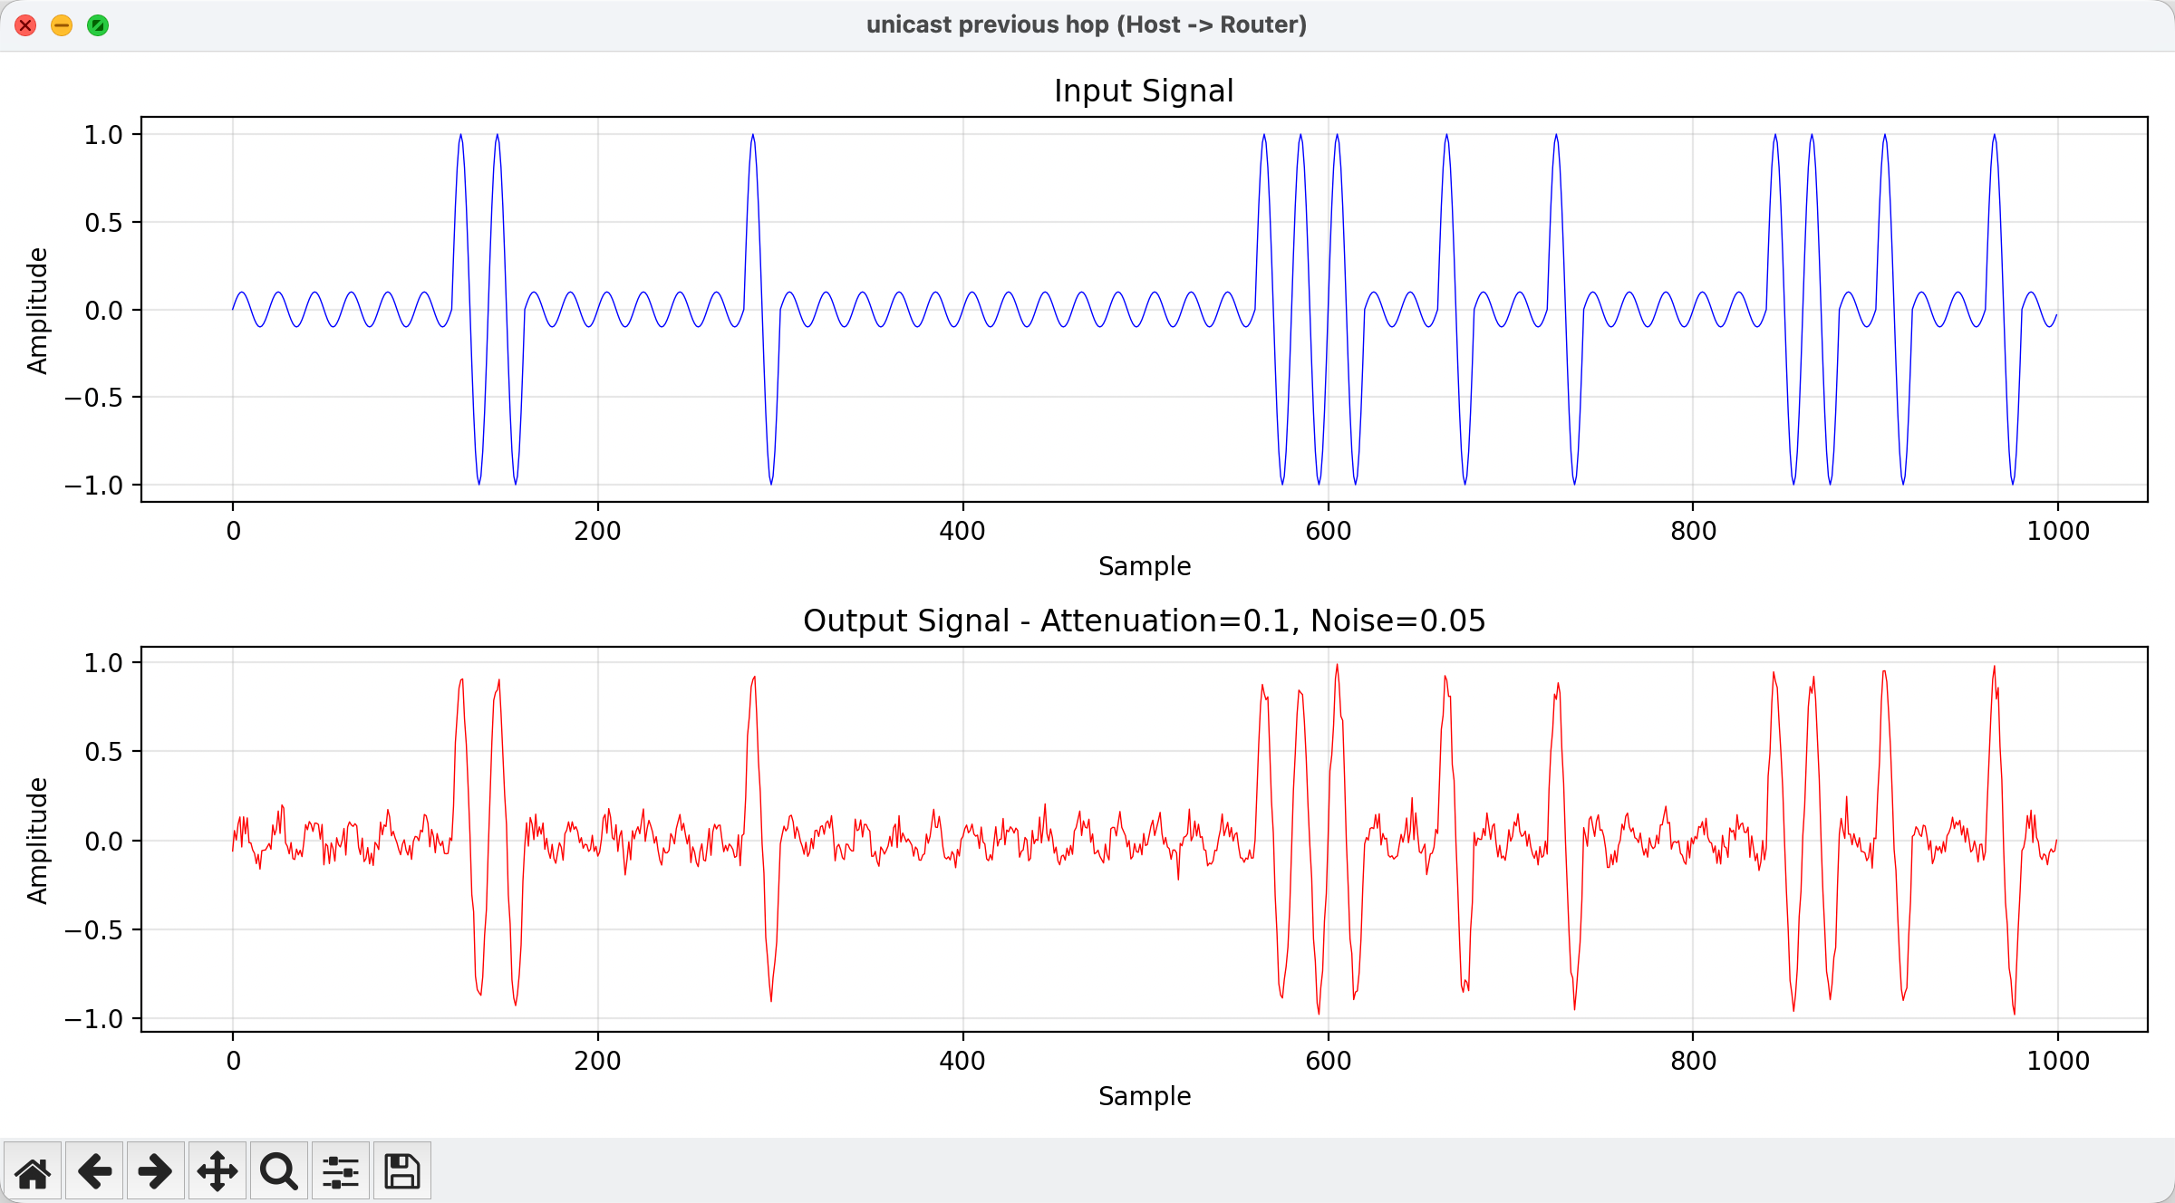
Multi-host: Result
Southern University of Science and Technology

Slide 22
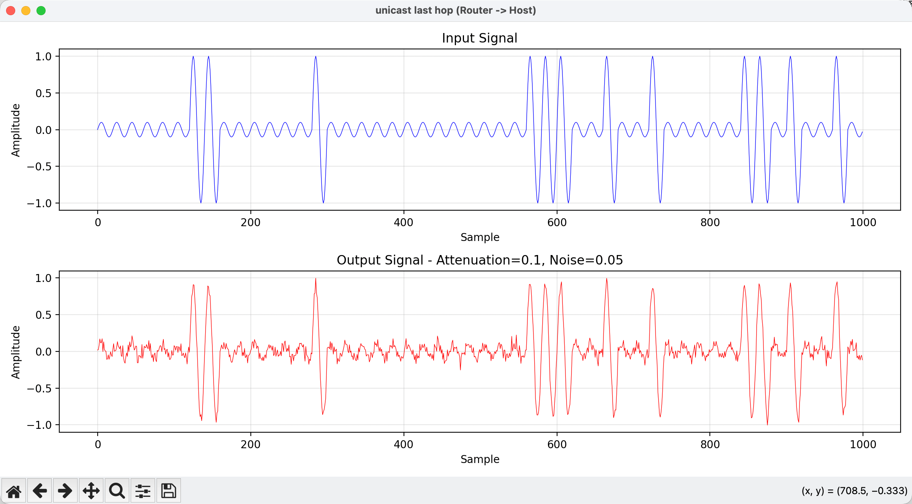
Multi-host: Result
Southern University of Science and Technology

Slide 23
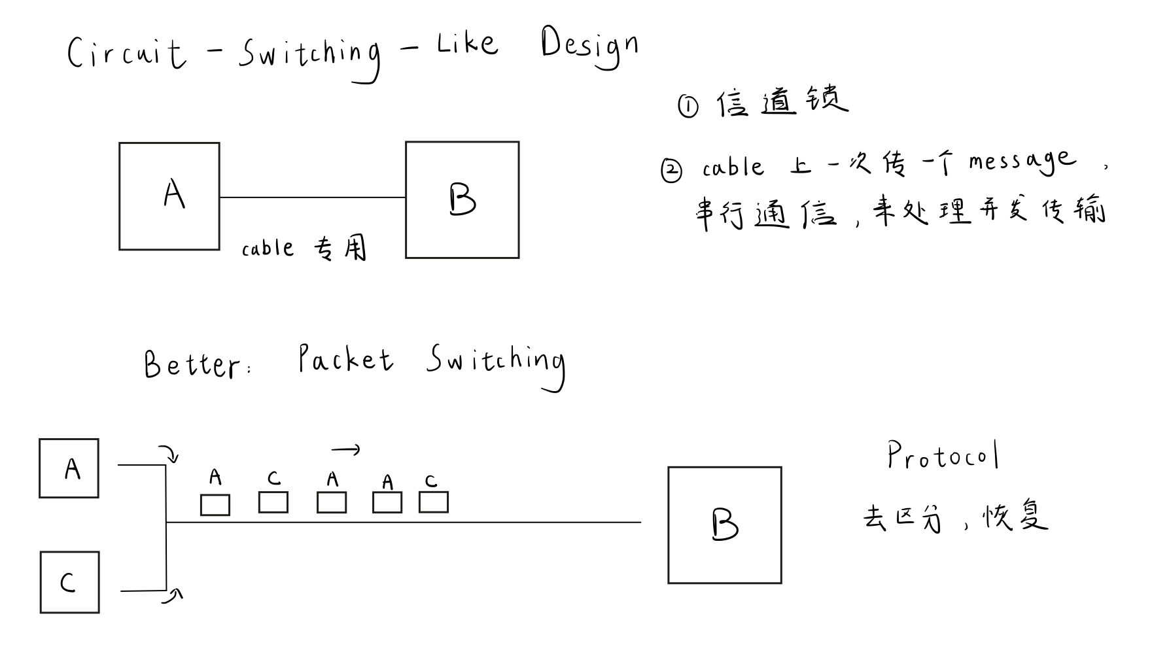
Multi-host: Result (simultaneous transmission)
Southern University of Science and Technology

Slide 24
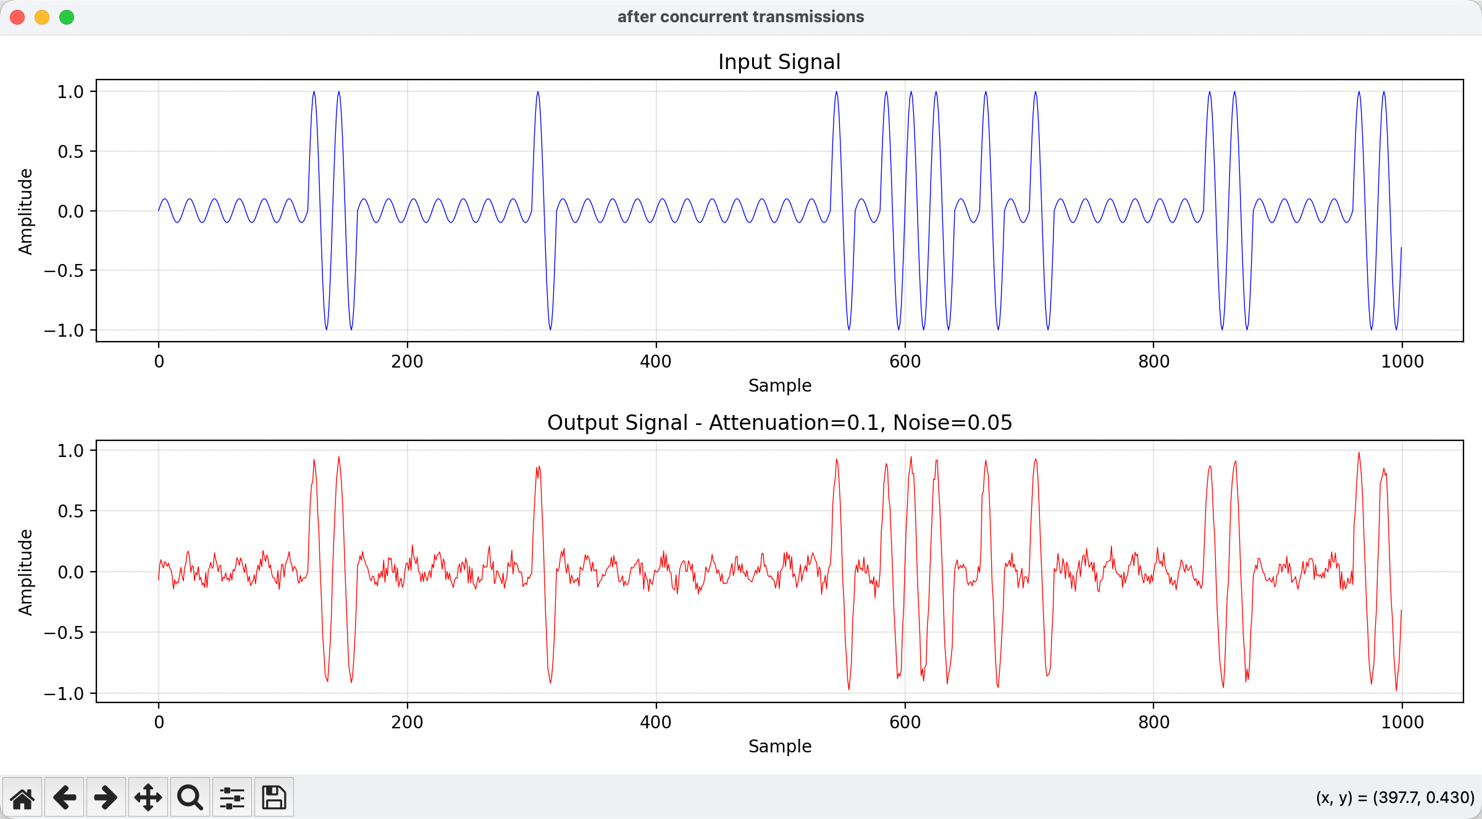
Multi-host: Result (simultaneous transmission)
Southern University of Science and Technology

Slide 25
Thank You!
I am open to any questions you may have.
Southern University of Science and Technology

